Slide 1
Agile Process
Text Book Reference:
Roger S. Pressman, Software Engineering – A Practitioner‟s Approach, Seventh Edition, Mc Graw-Hill International Edition, 2010.

Slide 2
The Manifesto for Agile Software Development
“We are uncovering better ways of developing software by doing it and helping others do it. Through this work we have come to value:
Individuals and interactions over processes and tools
Working software over comprehensive documentation
Customer collaboration over contract negotiation
Responding to change over following a plan
That is, while there is value in the items on the right, we value the items on the left more.”
Kent Beck et al

Slide 3
AGILE MANIFESTO

Slide 4
What is “Agility”?
Effective (rapid and adaptive) response to change
Effective communication among all stakeholders
Drawing the customer onto the team
Organizing a team so that it is in control of the work performed
Yielding …
Rapid, incremental delivery of software

Slide 5
What is “Agility”?
Agile is a time boxed, iterative approach to software delivery that builds software incrementally from the start of the project, instead of trying to deliver it all at once near the end.
It works by breaking projects down into little bits of user functionality called user stories, prioritizing them, and then continuously delivering them in short two week cycles called iterations.

Slide 6
Why Use Agile Methods
Improve Customer Involvement
Increase Quality
Simplify Releases
Drive Down Risk

Slide 7
WATERFALL vs AGILE

Slide 8
WATERFALL vs AGILE

Slide 9
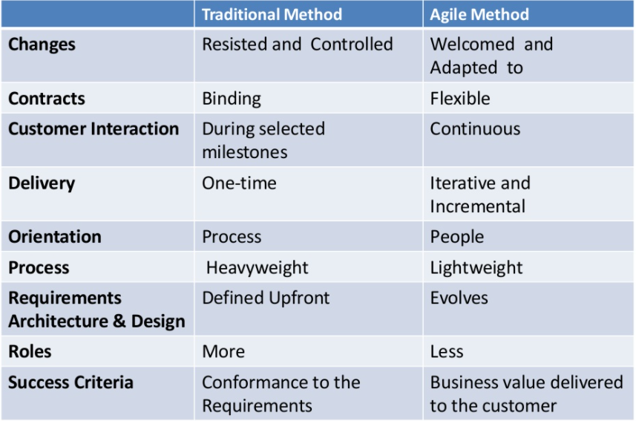
Agile Vs Traditional Methods

Slide 10
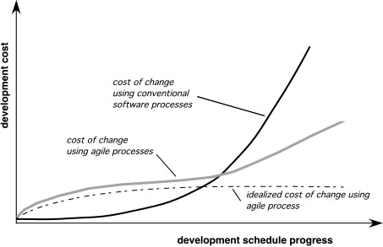
Agility and the Cost of Change

Slide 11
An Agile Process
Is driven by customer descriptions of what is required (scenarios)
Recognizes that plans are short-lived
Develops software iteratively with a heavy emphasis on construction activities
Delivers multiple ‘software increments’
Adapts as changes occur

Slide 12
Agility Principles - I
1. Our highest priority is to satisfy the customer through early and continuous delivery of valuable software.
2. Welcome changing requirements, even late in development. Agile processes harness change for the customer's competitive advantage.
3. Deliver working software frequently, from a couple of weeks to a couple of months, with a preference to the shorter timescale.
4. Business people and developers must work together daily throughout the project.
5. Build projects around motivated individuals. Give them the environment and support they need, and trust them to get the job done.
6. The most efficient and effective method of conveying information to and within a development team is face–to–face conversation.

Slide 13
Agility Principles - II
7. Working software is the primary measure of progress.
8. Agile processes promote sustainable development. The sponsors, developers, and users should be able to maintain a constant pace indefinitely.
9. Continuous attention to technical excellence and good design enhances agility.
10. Simplicity – the art of maximizing the amount of work not done – is essential.
11. The best architectures, requirements, and designs emerge from self–organizing teams.
12. At regular intervals, the team reflects on how to become more effective, then tunes and adjusts its behavior accordingly.

Slide 14
Human Factors
The process molds to the needs of the people and team, not the other way around
key traits must exist among the people on an agile team and the team itself:
Competence.
Common focus.
Collaboration.
Decision-making ability.
Fuzzy problem-solving ability.
Mutual trust and respect.
Self-organization.

Slide 15
Agile Methods
Agile methods:
Scrum
Extreme Programming (XP)
Adaptive Software Development (ASD)
Dynamic System Development Method (DSDM)
Agile modeling
Agile Unified Process (AUP)
Crystal Clear Methods
Disciplined agile delivery
Feature-driven development (FDD)
Lean software development
Kanban (development)
Scrumban
Agile Alliance
A non-profit organization promotes agile development

Slide 16
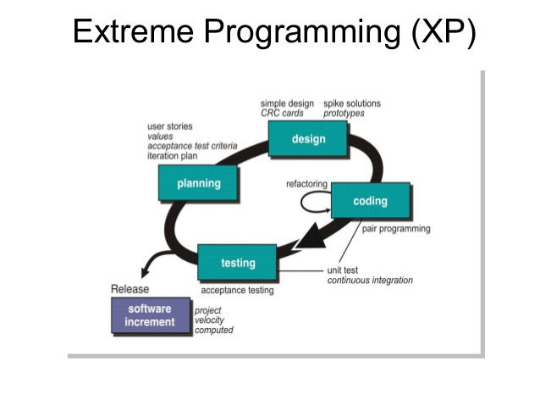
Extreme Programming (XP)

Slide 17
Extreme Programming (XP)
The most widely used agile process, originally proposed by Kent Beck
XP Planning
Begins with the creation of “user stories”
Agile team assesses each story and assigns a cost
Stories are grouped to for a deliverable increment
A commitment is made on delivery date
After the first increment “project velocity” is used to help define subsequent delivery dates for other increments

Slide 18
Extreme Programming (XP)
XP Design
Follows the K.I.S (Keep It Simple) principle
Encourage the use of CRC cards (see Chapter 8)
For difficult design problems, suggests the creation of “spike solutions”—a design prototype
Encourages “refactoring”—an iterative refinement of the internal program design
XP Coding
Recommends the construction of a unit test for a store before coding commences
Encourages “pair programming”
XP Testing
All unit tests are executed daily
“Acceptance tests” are defined by the customer and executed to assess customer visible functionality

Slide 19
Core Values of XP
Communication
Simplicity
Feedback
Courage
Respect

Slide 20
XP Values: Communication
Poor communication in software teams is one of the root causes of failure of a project
Stress on good communication between all stakeholders--customers, team members, project managers
Customer representative always on site
Paired programming

Slide 21
XP Values: Simplicity
‘Do the Simplest Thing That Could Possibly Work’
Implement a new capability in the simplest possible way
Refactor the system to be the simplest possible code with the current feature set
‘You Aren’t Going to Need It’
Never implement a feature you don’t need now
Developers strive to write simple code bringing more value to a product, as it saves time and effort.

Slide 22
XP Values: Feedback
Always a running system that delivers information about itself in a reliable way
The system and the code provides feedback on the state of development
Catalyst for change and an indicator of progress

Slide 23
XP Values
Courage. Programmers objectively evaluate their own results without making excuses and are always ready to respond to changes.
Respect. The agile team inculcates respect among it members, between other stakeholders and team members, and indirectly, for the software itself.

Slide 24
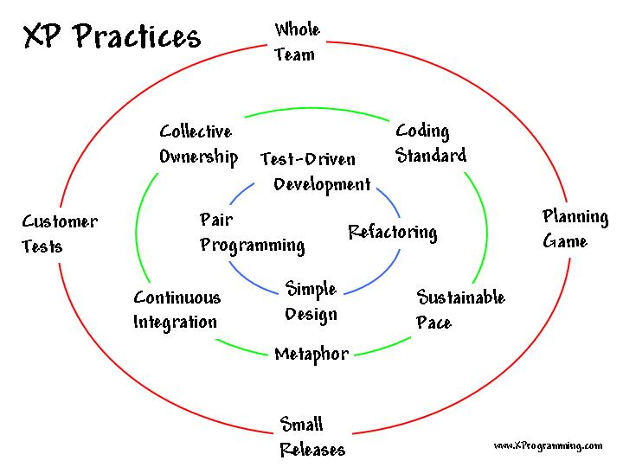
XP Practices
(Source: http://www.xprogramming.com/xpmag/whatisxp.htm)

Slide 25
XP Practices: Planning Game
Planning for the upcoming iteration
Uses stories provided by the customer
Technical persons determine schedules, estimates, costs, etc
A result of collaboration between the customer and the developers
Advantages
Reduction in time wasted on useless features
Greater customer appreciation of the cost of a feature
Less guesswork in planning
Disadvantages
Customer availability
Is planning this often necessary?

Slide 26
XP Practices: Planning Game
XP Release Planning
Customer presents required features
Programmers estimate difficulty
Imprecise but revised regularly
XP Iteration Planning
Two week iterations
Customer presents features required
Programmers break features down into tasks
Team members sign up for tasks
Running software at end of each iteration

Slide 27
XP Practices: Small Releases
Small in terms of functionality
Team releases running, tested software every iteration
The Customer can evaluate or in turn, release to end users, and provide feedback
Important thing is that the software is visible and given to the Customer at the end of every iteration
Advantages
Frequent feedback
Tracking
Reduce chance of overall project slippage
Disadvantages
Not easy for all projects
Versioning issues

Slide 28
XP Practices: Metaphor
The oral architecture of the system
XP Teams develop a common vision of the system
Define common system of names
Ensure everyone understands how the system works, where to look for functionality, or where to add functionality
Advantages
Encourages a common set of terms for the system
A quick and easy way to explain the system

Slide 29
XP Practices: Simple Design
Build software to a simple design
Through programmer, testing and design improvement, keep the software simple and the design suited to current functionality
Not a one-time thing nor an up-front thing
Design steps in release planning and iteration planning
Teams design and revise design through refactoring, through the course of the project
Advantages
Easier to understand what is going on
Refactoring and collective ownership is made possible
Helps keeps programmers on track

Slide 30
XP Practices: Pair Programming
Two Developers, One monitor, One Keyboard
One “drives” and the other thinks
Switch roles as needed
Research into pair programming shows that pairing produces better code in the same time as programmers working singly
Pairing also communicates knowledge throughout the team

Slide 31
XP Practices: Test-Driven Development
Teams practice TDD by working in short cycles of adding a test, and then making it work
Easy to produce code with 100 percent test coverage
These programmer tests or unit tests are all collected together
Each time a pair releases code to the repository, every test must run correctly

Slide 32
XP Practices: Design Improvement/ Refactoring
Continuous design improvement process called ‘refactoring’:
Removal of duplication
Increase cohesion
Reduce coupling
Refactoring is supported by comprehensive testing--customer tests and programmer tests
Prompts developers to proactively improve the product as a whole
Increases developer knowledge of the system

Slide 33
XP Practices: Continuous Integration
New features and changes are worked into the system immediately
Teams keep the system fully integrated at all times
Daily, or multiple times a day builds
Avoid ‘integration hell’
Avoid code freezes

Slide 34
XP Practices: Coding Standard
Use common coding standard
All code in the system must look as though written by an individual
Code must look familiar, to support collective code ownership

Slide 35
XP Practices: Collective Code Ownership
Any pair of programmers can improve any code at any time
No ‘secure workspaces’
All code gets the benefit of many people’s attention
Avoid duplication
Programmer tests catch mistakes
Pair with expert when working on unfamiliar code

Slide 36
XP Practices: Sustainable Pace/40-Hour Week
The work week should be limited to 40 hours
Team will produce high quality product when not overly exerted
‘Death march’ projects are unproductive and do not produce quality software
Work at a pace that can be sustained indefinitely

Slide 37
XP Practices: Whole Team
All contributors to an XP project are one team
Must include a business representative--the ‘Customer’
Provides requirements
Sets priorities
Steers project
Team members are programmers, testers, analysts, coach, manager
Best XP teams have no specialists

Slide 38
XP Practices: Customer Tests/Testing
The Customer defines one or more automated acceptance tests for a feature
Team builds these tests to verify that a feature is implemented correctly
Once the test runs, the team ensures that it keeps running correctly thereafter
System always improves, never backslides
Unit testing
Test-first design
All automated

Slide 39
Scrum
Originally proposed by Jeff Sutherland and extended by Schwaber and Beedle.
Scrum—distinguishing features
Development work is partitioned into “packets”
Testing and documentation are on-going as the product is constructed
Work occurs in “sprints” and is derived from a “backlog” of existing requirements
Meetings are very short and sometimes conducted without chairs
“demos” are delivered to the customer with the time-box allocated

Slide 40
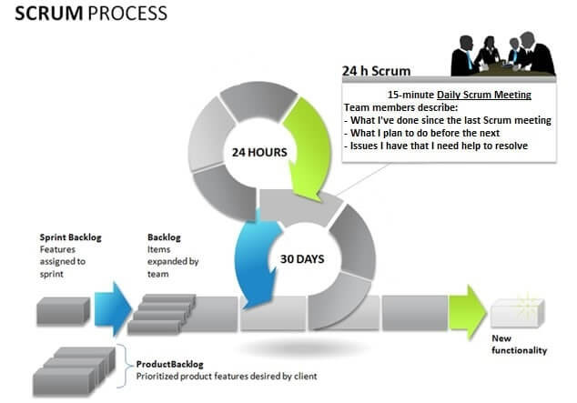
Scrum

Slide 41
Team
Seven (plus/minus two) members
Is cross-functional (Skills in testing, coding, architecture etc.)
Selects the Sprint goal and specifies work results
Has the right to do everything within the boundaries of the project guidelines to reach the Sprint goal
Organizes itself and its work
Demos work results to the Product Owner.

Slide 42
Scrum Master
Ensure that the team is fully functional and productive
Enable close cooperation across all roles and functions
Remove barriers
Shield the team from external interferences during the Sprint
Ensure that the process is followed, including issuing invitations to Daily Scrum, Sprint Review and Sprint Planning meetings.

Slide 43
Product Owner
Define the features of the product.
Decide on release date and content.
Be responsible for the profitability of the product (ROI).
Prioritize features according to market value.
Adjust features and priority every iteration, as needed
Accept or reject work results.

Slide 44
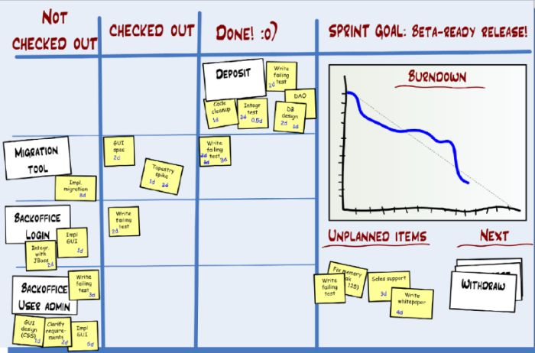
Burndown Chart
Notes:
The Burndown Chart tracks your progress in the sprint. It measures the amount of work remaining in the sprint, or the estimated amount of work remaining in the sprint. It lets the team see at a glance if they are on track to deliver the sprint backlog.

Slide 45
XP vs Scrum
Aspects | XP | Scrum
Iteration Length | 1-2 weeks | 2-4 weeks
Handle Changes with an Iteration | It can be replaced with other requirements when a need is not implemented, but the implementation time is equal. | Scrum is not allowed to do this. Once the iteration is completed, no changes are allowed, and Scrum Master is strictly checked.
Priority of Features | Yes | No need to
Engineering Practices | Very strict | Require developers to be conscious

Slide 46
Adaptive Software Development
Originally proposed by Jim Highsmith
ASD — distinguishing features
Mission-driven planning
Component-based focus
Uses “time-boxing” (See Chapter 24)
Explicit consideration of risks
Emphasizes collaboration for requirements gathering
Emphasizes “learning” throughout the process

Slide 47
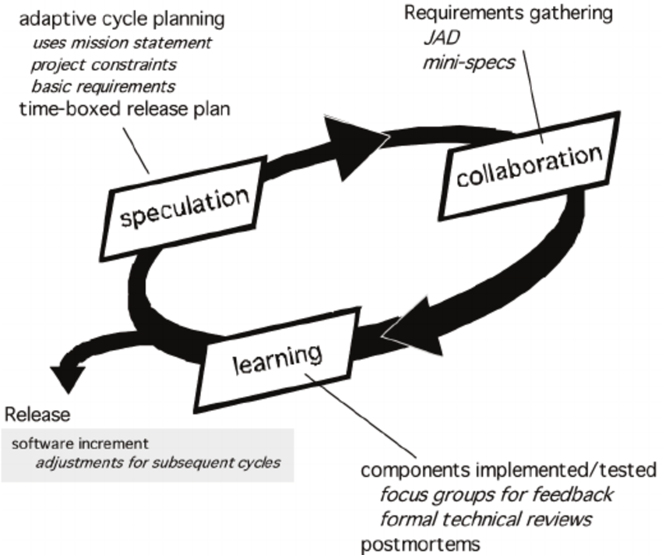
Adaptive Software Development

